Slide 1
Azure DevOps
Week 3

Slide 2
What is DevOps
DevOps provide us with various tools for development, testing and operations (deployment, monitoring etc.) integrated into a single environment
It allows collaborative management of project between developers and operations unit to reduce friction among them and increase productivity

Slide 3
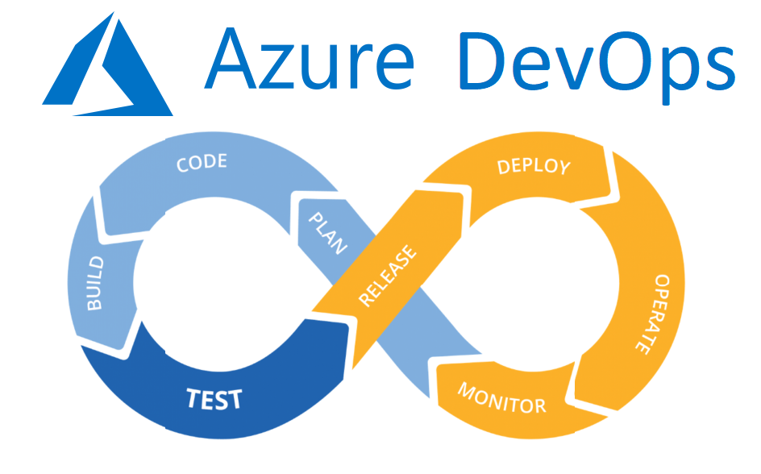

Slide 4
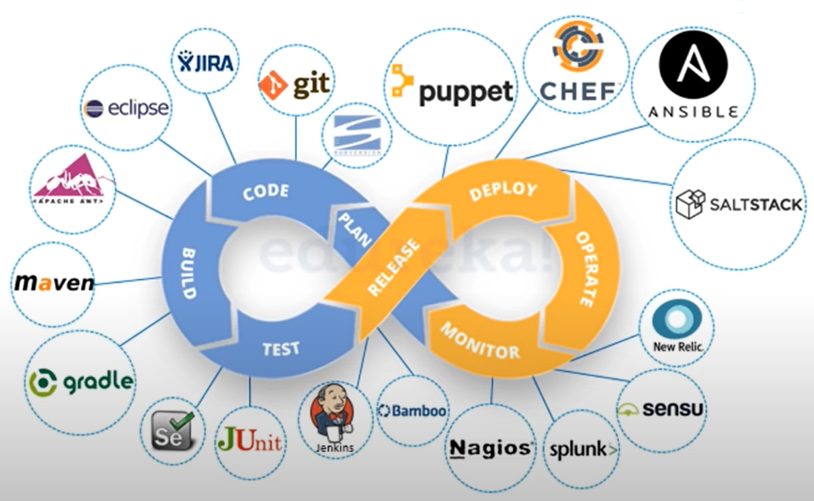
Azure DevOps Tools

Slide 5
Getting Started
You need to have a Microsoft account for Azure DevOps
Although you can use any other IDE but MS Visual Studio 2017/19 is recommended for this course

Slide 6
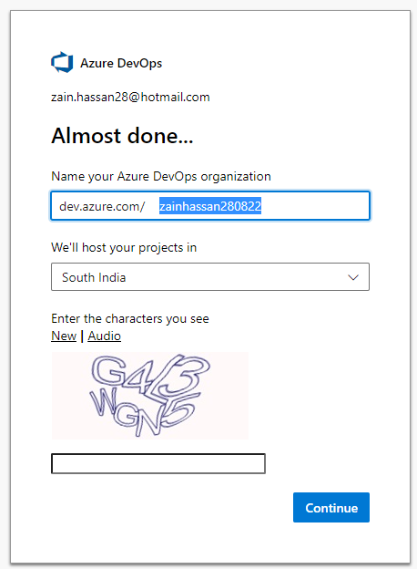
Create Organization

Slide 7
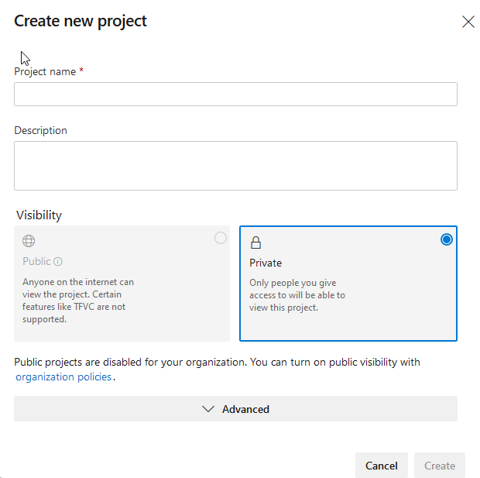

Slide 8
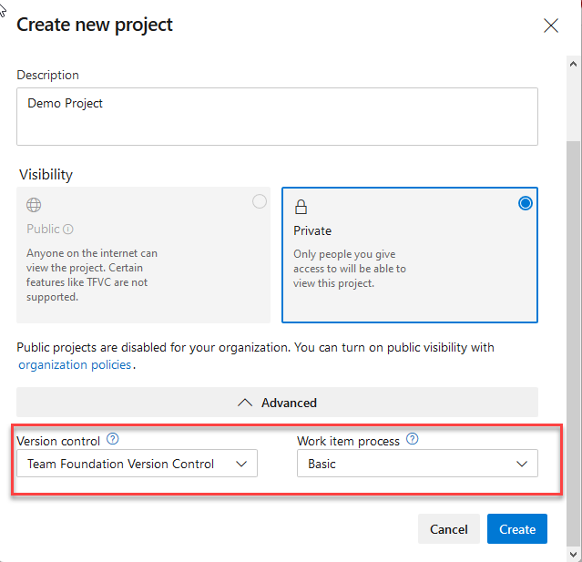

Slide 9
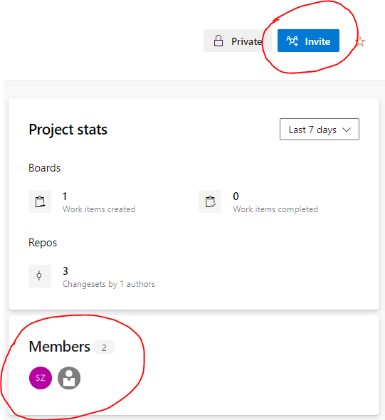
Project Members

Slide 10
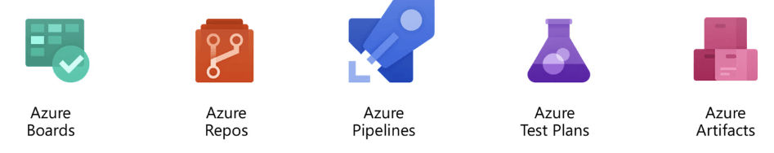
Azure DevOps Components

Slide 11
Azure Boards
Used to plan, track and discuss the work across different teams in the project
We can create issues, epics, tasks and manage sprints along with various other project management related activities

Slide 12
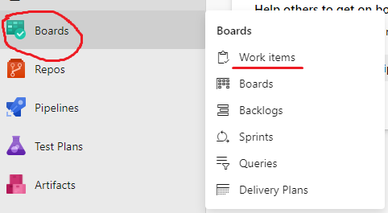
Work Items

Slide 13
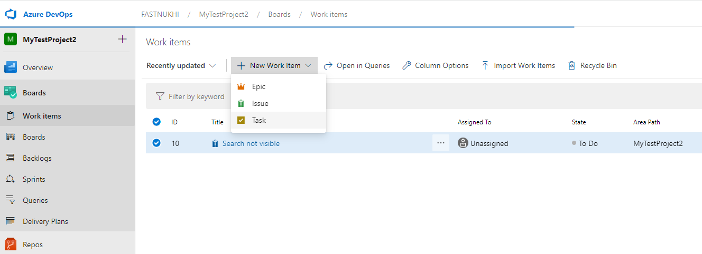
Work Items

Slide 14
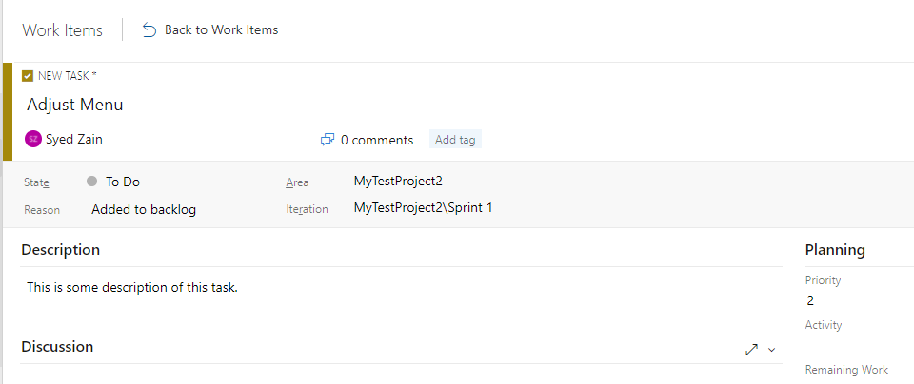
Work Items

Slide 15
Azure Repos
Provides with repositories for checking-in code
Currently, Git and Team Foundation Version Control (TFVC) are available with Azure DevOps

Slide 16
Connecting Solution to Repo
Start Visual Studio and create a web application project
Open Team Explorer
Do the changes in code

Slide 17
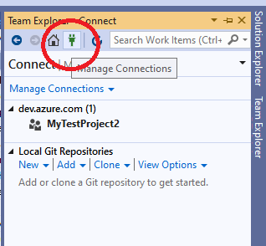
Connecting Solution to Repo
Open Team Explorer in your Solution (located under the View option)
Click on Manage Connections icon

Slide 18
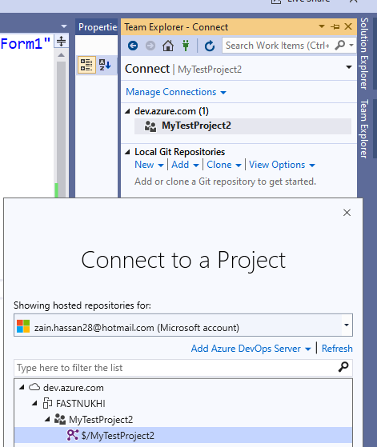
Connecting Solution to Repo
Connect to a project

Slide 19
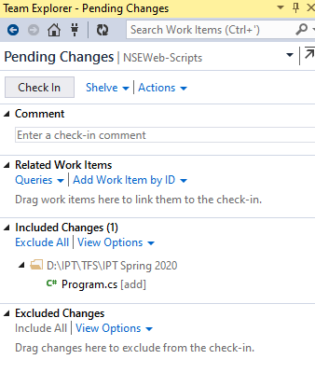
Connecting Solution to Repo
Any pending changes you make to your code/solution can be ‘Check in’ to Azure DevOps

